Slide 1
How to Interview a Software Architect II
Introduction
The purpose of this video is express in common terms those concepts and questions used to interview and evaluate a software architect.
For an Interview, we’ll talk about
Construction
Project Management
“Explain Integration
Strategies?”
What are
Construction Logistics?
Previous discussion covered the more abstract concepts of software architecture. Here we’ll talk about more practical concerns.
Additionally, we’ll try to stay outside of platforms and implementation technologies.
About Matthew Burnett
25 years experience programming
MA Industrial Psychology
Many software certifications

Slide 2
Choosing Interview Strategy and Emphasis
Strategic Points
Many Software ‘Experts’ do not know: (As a review…)
The fundamental reference in the book “Design Patterns” (GoF), which is generally accepted as the ‘Standard’ in software design, is “A Pattern Language” by C. Alexander. Most texts describing software architecture both quote and reference “Design Patterns” and “A Pattern Language” as the conceptual scaffolding supporting an intellectual point of view.
A “Building Architect” – might ‘Architect’ by:
Envision – Examine stakeholder goals combined with architect’s expertise
Model – View the ‘lay of the land’ to construct a model and set expectations
Blueprint – Specify construction details and constraints
Inspect – Verify construction implementation
Nomenclature – communicate in terms understandable to listeners
A “Software Architect” – might ‘Architect’ by:
Envision – Form outcomes and behaviors as guide to structure in solution delivery
Model – Implement known Design Patterns to ensure success and cost control
Blueprint – Guide Construction and Design Principles providing roadmap to deliverables
Inspect – Verify construction implementation
Nomenclature – communicate in standard terms understandable to listeners

Slide 3
Software ‘Construction’ Concepts
Strategic Points
Construction
Future/indication
Past/verification
Blueprint
Significant Use Case
Structural Intent
Architecture
Technology
Construction Methods
Build
Inspect
Significant Use Case
Structural Intent
Architecture
Technology
Construction Methods
A good rule of thumb – “Design and Construction meet
on the principles of Cohesion and Coupling.”
Let take a look at an example.
Reference
Construction - Wikipedia

Slide 4
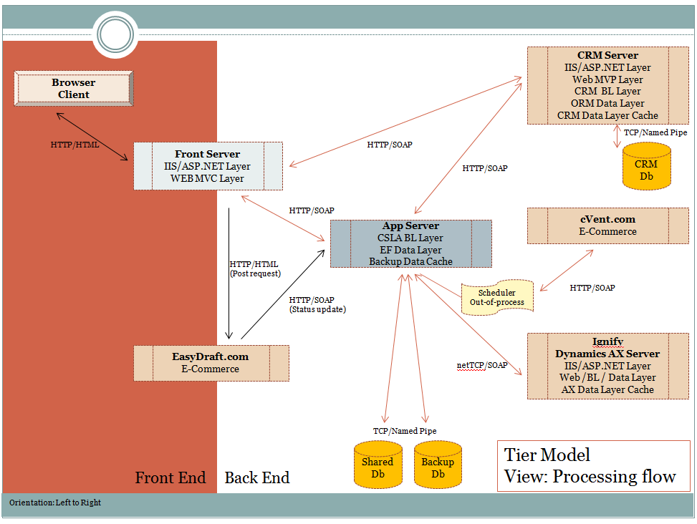
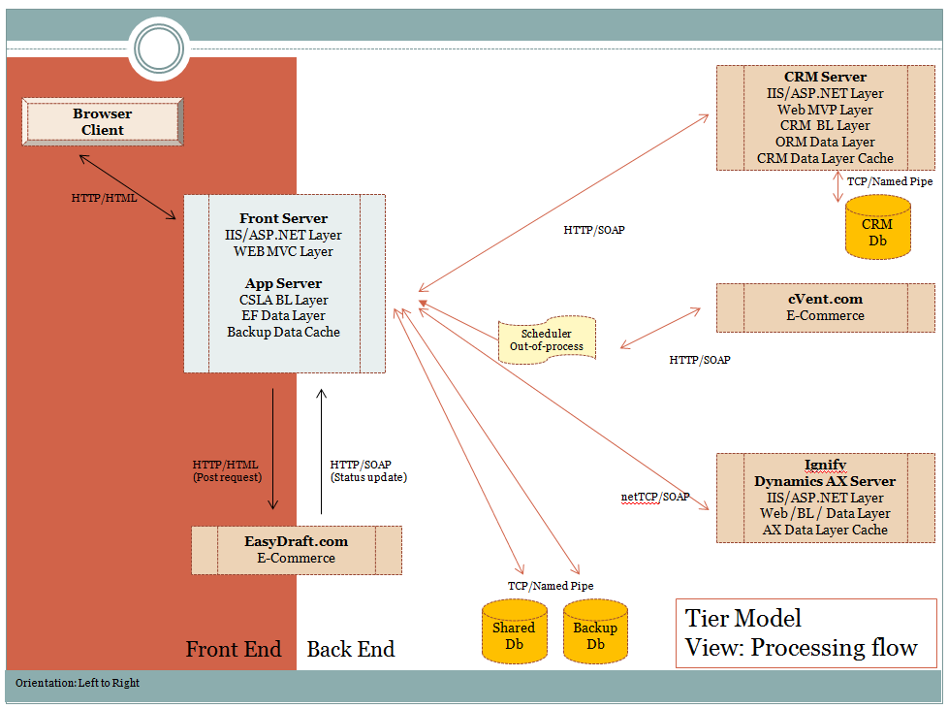
Example: Comparing Architectures
Construction
What difference do you see?

Slide 5
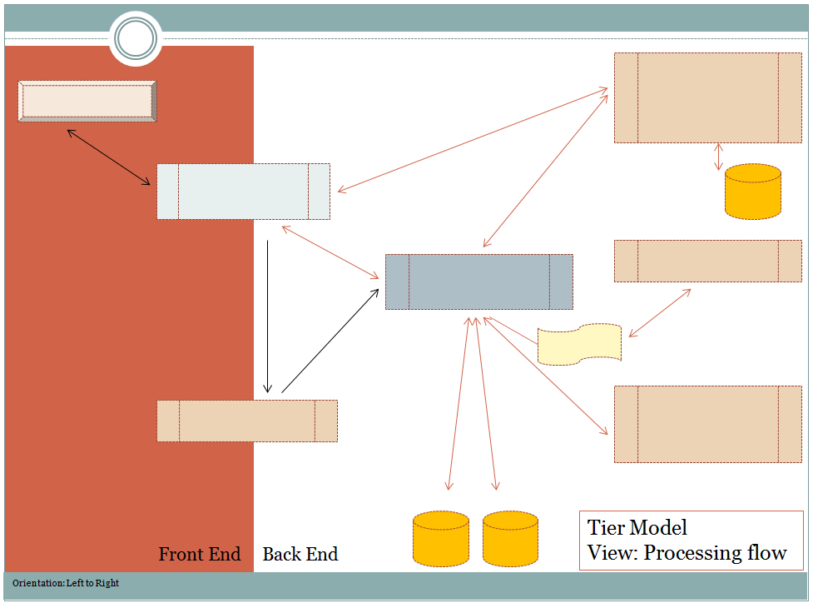
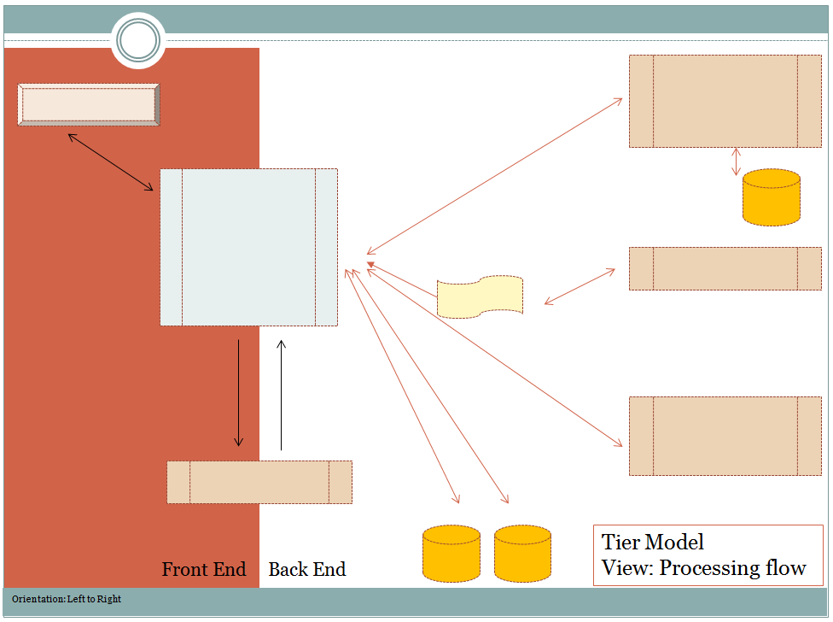
Example: Comparing Architectures
Construction
A clear picture of the difference can be obtained by removing the descriptive labels.
The two architectures are the same;
same code, layers, databases?
This architecture is more cohesive -- >
This architecture has fewer couplings -- >
Construction effects Architecture.
Which is more scalable?

Slide 6
Construction Influence
Strategic Points
Construction Patterns
Inheritance Design
Component Design
Layered Design
Tier Design
Delivery Methodology
Architecture erosion
Influence
Construction Implementation
Structural Implementation
Project management
Process and delivery logistics
Construction methods
Tools
Communication
Physical structure
CPU-Process Integration
Latency
Notice that “Construction Patterns” influence Implementation. Indeed, pattern selection determines Project Mgmt., methods, tools & physical structure in most cases.
Do Cloud Architectures simply
Reflect choices in Construction Patterns?

Slide 7
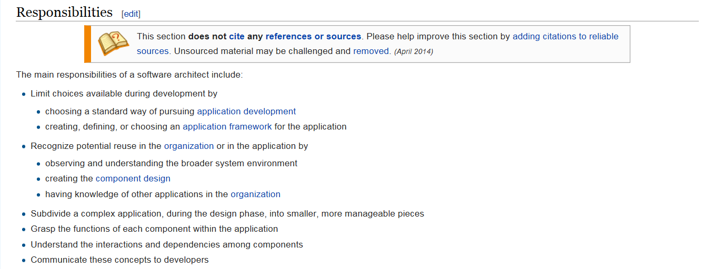
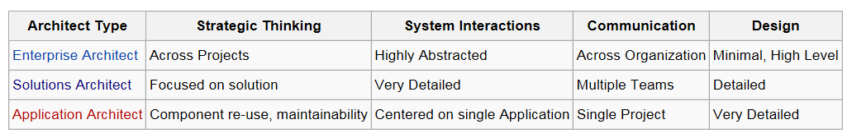
Architects and Construction
Architect Responsibilities
As an external reference, how does Wikipedia list the Roles and Responsibilities of Architects…
The table below indicates many of the differences between various kinds of software architects. They may have different goals and scope, but knowledge is fundamentally the same.
Source: Wikipedia “Software Architect”

Slide 8
‘Reading’ into an Interview Response
Implicit knowledge of responses
Evaluating a candidate
Questions have specific answers, but ‘it depends’ is also a valid answer. In such cases, we need to examine the way a response is given to rate it.
Most replies should be specific, opinioned but softly spoken – Candidates need to have an opinion and state it as such, but at the same time recognize other factors may influence outcomes.
Replies should use standard, architecturally known terms in response – Use of non-standard terms or not providing references (known examples) indicates lack of knowledge.
Replies can illustrate standard response Vs. minority response – However, candidates should clearly state the standard response to a design question. He may then reply with a minority held position to further support an opinion.
Interviewers should capture responses for review and follow-up – Ambiguous replies may be the fault of interviewer.
Materials Vs. Exotic Materials selection – Candidate should elaborate why selection of technologies could be knowledge/complexity/cost prohibitive.
Plasticity / Continuity (Blending solution modules implies flexibility of design) – Candidate replies should have undertone of flexibility/simplicity in design.

Slide 9
The “Right” Questions to Ask
Architecture Fundamentals
Comparing Architectures
What do highly cohesive Architectures look like?
Explain Integration Strategies?
In middle layer design, compare a Domain model with a Transaction Processing model
Compare a Pipeline and a Component Architecture
Physical Design
Why have logical and physical models?
Why have Process separation?
Explain a 3 Layer and 1 Tier Architecture?
Give an example of a “n” Layer / 1 Tier Architecture that meets its business constraints.
Construction
What are the logistical hazards of Software Construction (assembly)?
What is Continuous Delivery
Contrast a Cloud Solution delivery with a Self hosted solution delivery
Construction Complexity? – Module complexity is an exponential risk in delivery logistics
Who is Steve McConnel?
Project Management
What is the role of a Project manager?
Have you reviewed “the Agile Manifesto”? What is its objective?
DevOps – What is this?
Testing components and delivery logistics (functional, performance, code coverage)
SLA – What is this?

Slide 10
What About “Customers”?
Other Things an Architect might know
Additional Considerations
Working with Customers– What opinion to have?
Project managers and representatives have “no” opinion in the structural integrality or delivery of a project.
Architects may want to:
Communicate the intent and set expectation of system use, scale, etc early on in project lifecycle.
A good architect always has a reference
– A substantive list providing citations for the facts, opinions,
or quotes that are presented.

Slide 11
References
Further Study
Wikipedia – Software Architecture
http://en.wikipedia.org/wiki/Software_architecture
Wikipedia –Applesoft BASIC
http://en.wikipedia.org/wiki/Applesoft_BASIC
ISO/IEC/IEEE 42010 Systems and software engineering
http://en.wikipedia.org/wiki/ISO/IEC_42010
Design Patterns
http://en.wikipedia.org/wiki/Design_Patterns
Wikipedia Software Architect
http://en.wikipedia.org/wiki/Software_architect
Code Complete 2, Steven McConnel, Microsoft Press, 2004

Slide 12
References
Further Study
Links
http://blogs.msdn.com/b/gabriel_morgan/archive/2007/09/02/enterprise-architect-vs-solution-architect.aspx
http://blogs.msdn.com/b/gabriel_morgan/archive/2009/03/02/inappropriately-comparing-building-architecture-and-software-architecture.aspx
http://blogs.msdn.com/b/gabriel_morgan/archive/2007/09/26/adoption-versus-architecture-versus-leadership.aspx
http://blogs.msdn.com/b/gabriel_morgan/archive/2006/10/20/solution-architect-skills-assessment-idea.aspx
http://stackoverflow.com/questions/2029690/application-architect-vs-systems-architect-vs-enterprise-architect
http://programmers.stackexchange.com/questions/110270/whats-the-difference-between-enterprise-architect-software-solution-architect
http://www.oracle.com/technetwork/articles/entarch/ricca-bridging-ea-sa-457138.html
Wikipedia –Applesoft BASIC
http://en.wikipedia.org/wiki/Applesoft_BASIC
ISO/IEC/IEEE 42010 Systems and software engineering
http://en.wikipedia.org/wiki/ISO/IEC_42010
Design Patterns
http://en.wikipedia.org/wiki/Design_Patterns
Wikipedia Solution Architecture
http://en.wikipedia.org/wiki/Solution_architecture

